Slide 1
Who’s Home - Final Demo
Joe and Myles

Slide 2
Project Goals
What We Did
-Create a functional and easy-to-use website
-Utilize the Raspberry Pi as much as possible to accomplish our goals
-Utilize face recognition/detection libraries to identify apartment dwellers
-Understand AWS and all of its useful features
-Main goal: Create a roommate tracking app to see who is home and who isn’t.
-Created a mediocre looking, but effective website
-Used Raspberry Pi motion sensor, RGB LED, and Pi Camera
-Spent a large amount of time working with the opencv and face_recognition Python libraries
-Waste several hours setting up ec2 instances that we did not end up using in the end.
-Created an app that works better than expected

Slide 3
Approach
Raspberry Pi:
-Configured to run a Python script on startup
-RGB LED indicator light
-Red blinking=connecting to wifi
-Blue solid=wait for motion
-Green blink=capturing images
-Green solid=sending images
-Motion Sensor
-Adjusted for our use case
-Pi Camera
-Decent picture quality; not great for moving bodies
-Ended up taking a burst of 5 pictures about .75 seconds apart
EC2 Instance:
-Hosted the website, processed images, and did heavy computations
-Using awscli was able to utilize s3 buckets as well as Cloud9 IDE
-Used to store datasets of our faces and encodings
-Processed burst of images takes by Raspberry Pi (detected faces, compared to dataset, and picked the best image to display on the website)

Slide 4
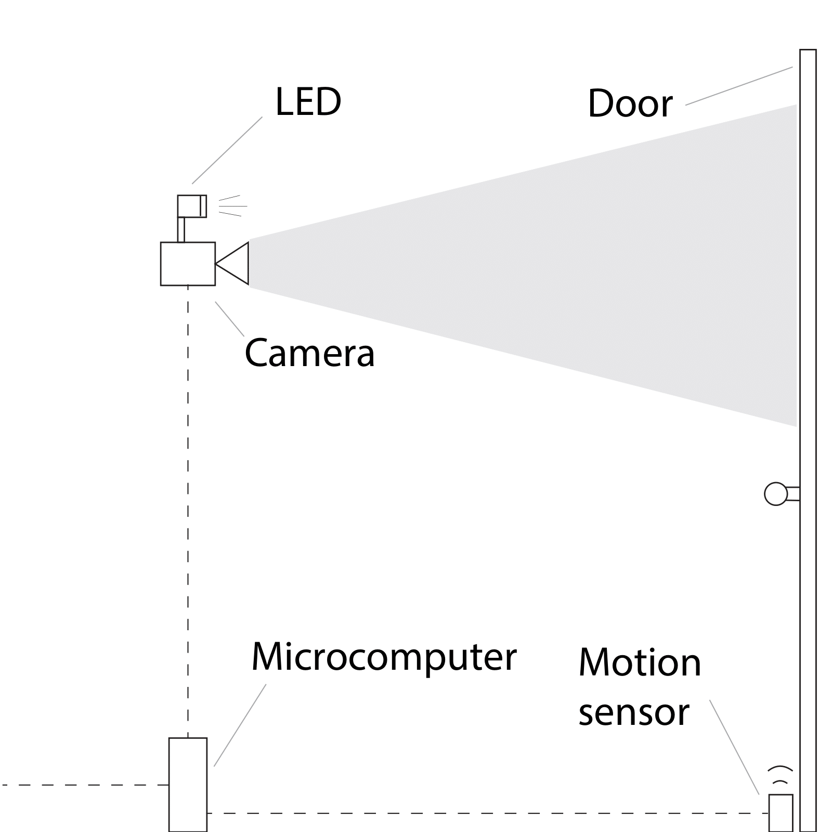
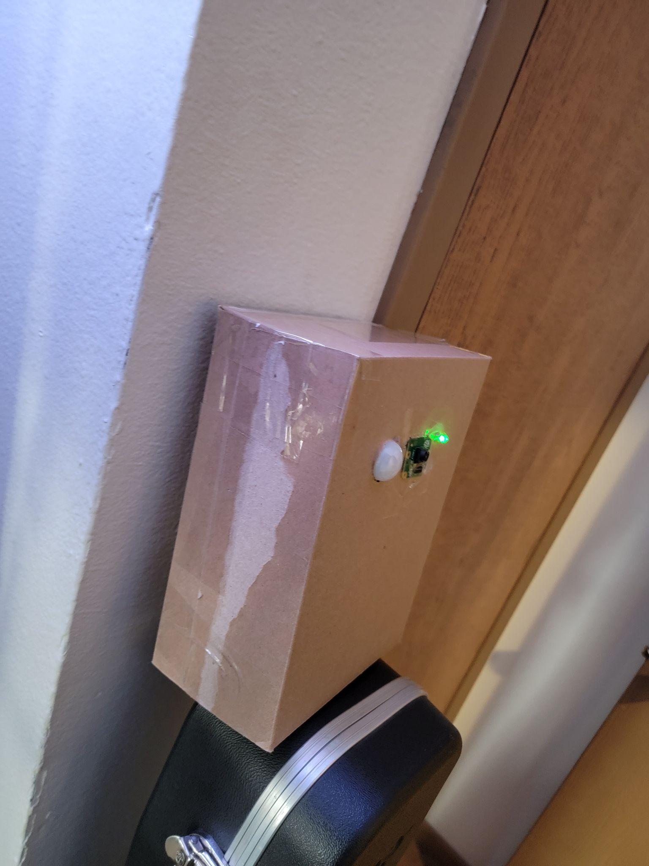
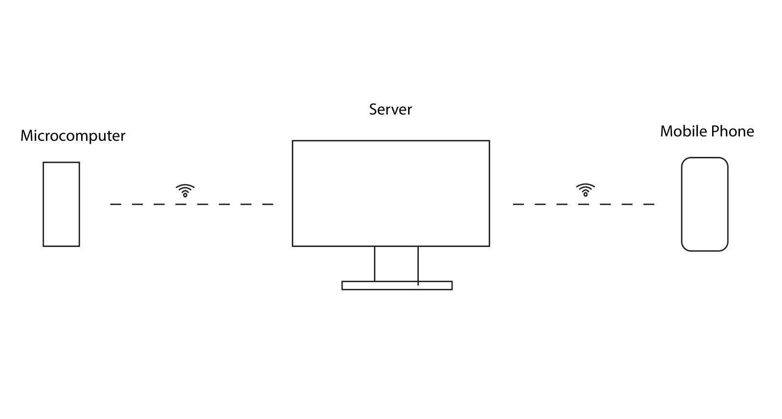
Approach illustrated

Slide 5
Related Work
Attendance using face_recognition project:
https://papers.ssrn.com/sol3/papers.cfm?abstract_id=3804334
Raspberry pi as Sensor node article:
https://www.researchgate.net/publication/332650003_Raspberry_Pi_as_Sensor_Node_and_Hardware_of_the_Internet_of_Things_Iot_for_Smart_Home
Raspberry Pi GPIO documentation:
https://gpiozero.readthedocs.io/en/stable/api_input.html

Slide 6
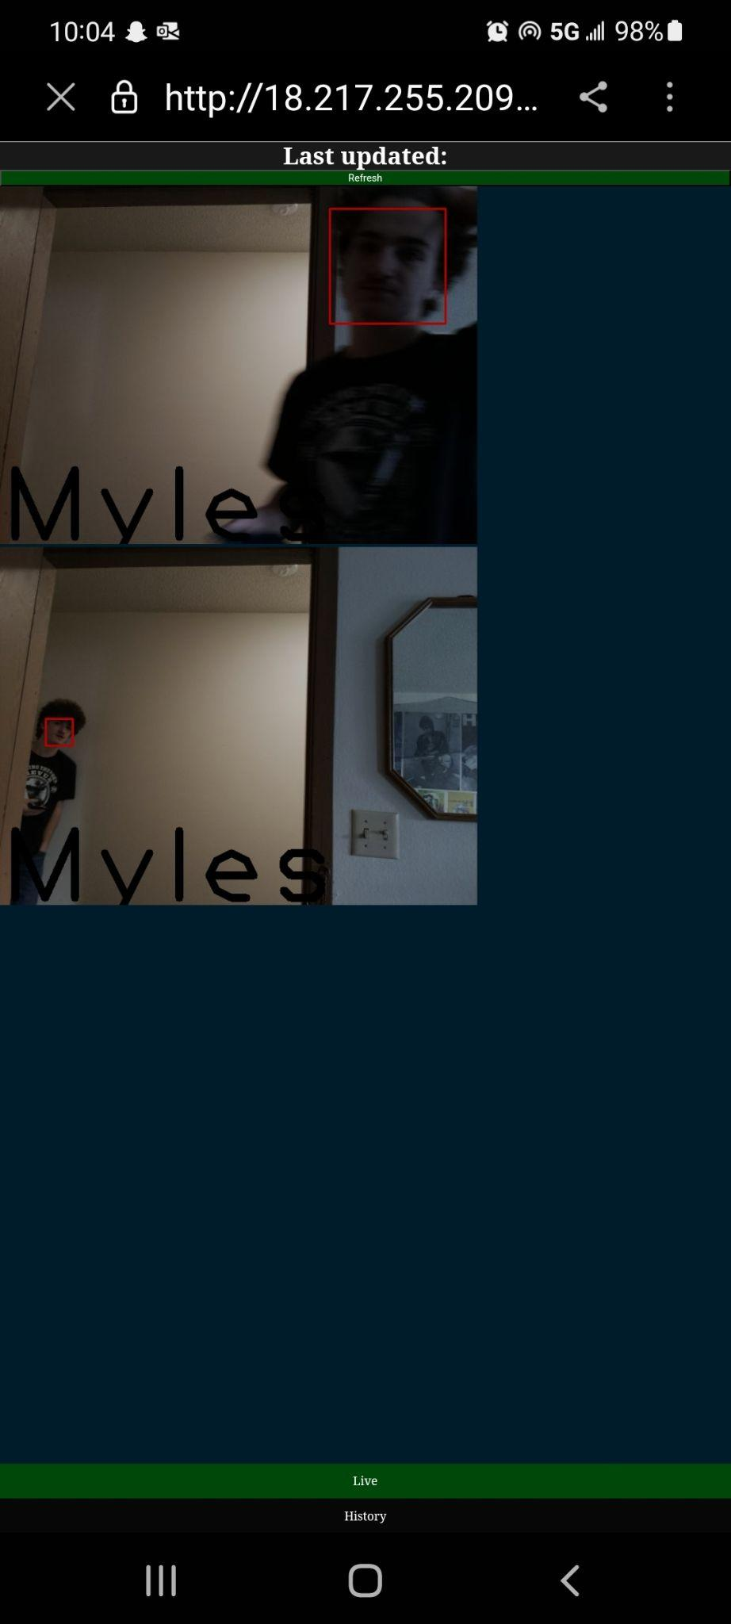
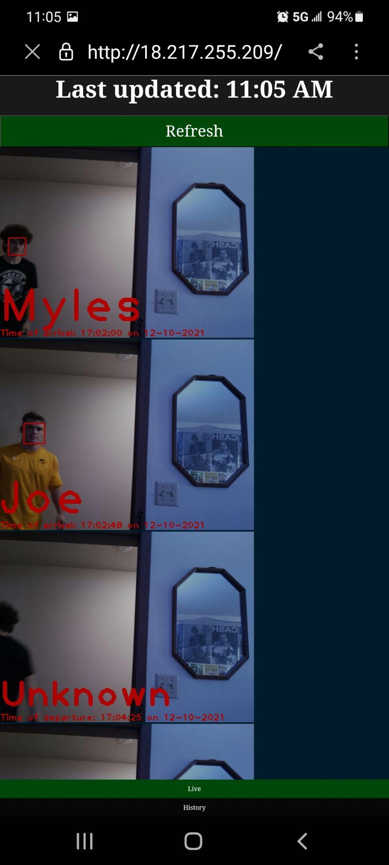
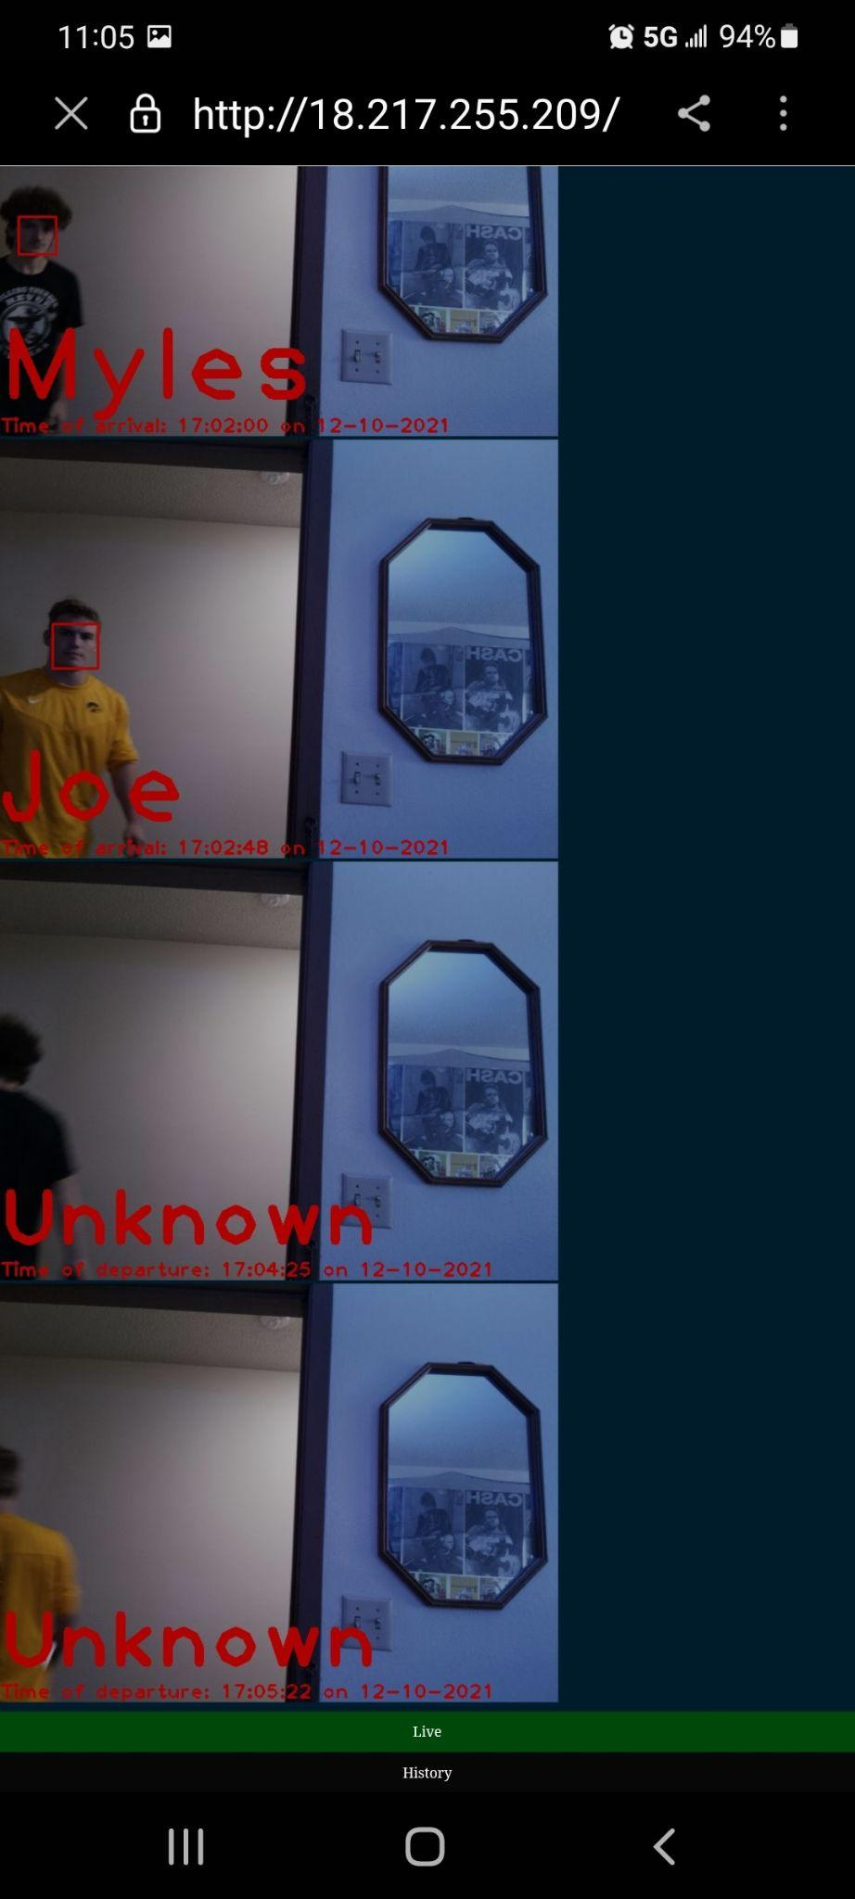
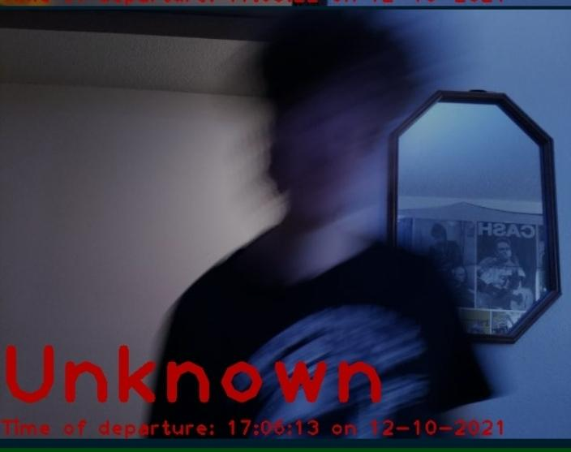
Experimentation
-Datasets
-How to deal with unknowns
-How rapidly and how many images to capture
-Ways of hosting the website

Slide 7

Demo Video

Slide 8
Hands-On Demo!

